Slide 1
Great ideas are worthless, unless you start execute them...

Slide 2
Let's start by putting your idea on the wall. after all, a journey of 10.000 steps starts with the first step...

Slide 3
Doing everything yourself….
Sounds like hard work, doesn’t it?

Slide 4
Brainblurb is proud to be a GSSN Studio, a highly curated community of studios, all over the world.

Slide 5
We are a startup studio based on a community of co-founders who are passionate and not scared to pioneer and take a chance. We love to create and build new companies and fully understand that it requires a special type of character to turn dreams into reality!
We are based in Alkmaar, and you are welcome to share your idea and join our
community of co-founders.
BRAINBLURB.COM

Slide 6
CORE VALUES

Slide 7
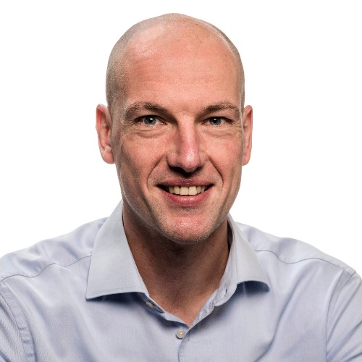
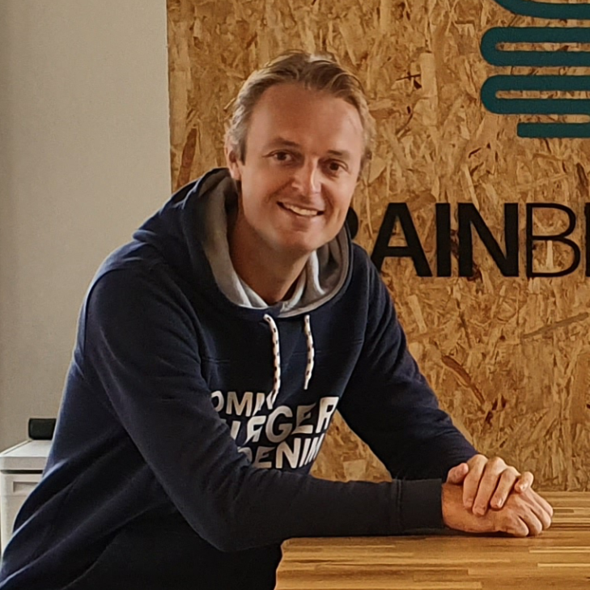
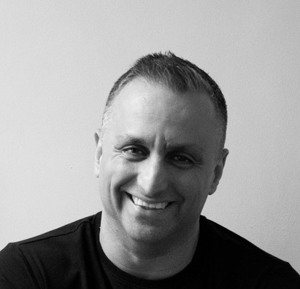
TEAM ALKMAAR
Ronny Schuijt
co-founder CFO
Dave Bibo
co-founder CTO
Sinan Gul
co-founder CVO

Slide 8
ADVISORY BOARD
Maria Bermudez Oviedo - CEO & co-founder at 7days2go
Vincent Bergsma - Intrapreneur at ABN AMRO
Hans Kwaad - CBDO at AutoBinck Group
Peter Vonk - CFO & founder Kaasstad Kapitaal
Dick Ettema - founder Jogoa / Marketing XL
Matthias van Alphen - CEO & co-founder at Connect Capital
Bjorn Erich - EMEA CFO at KAO corp.

Slide 9
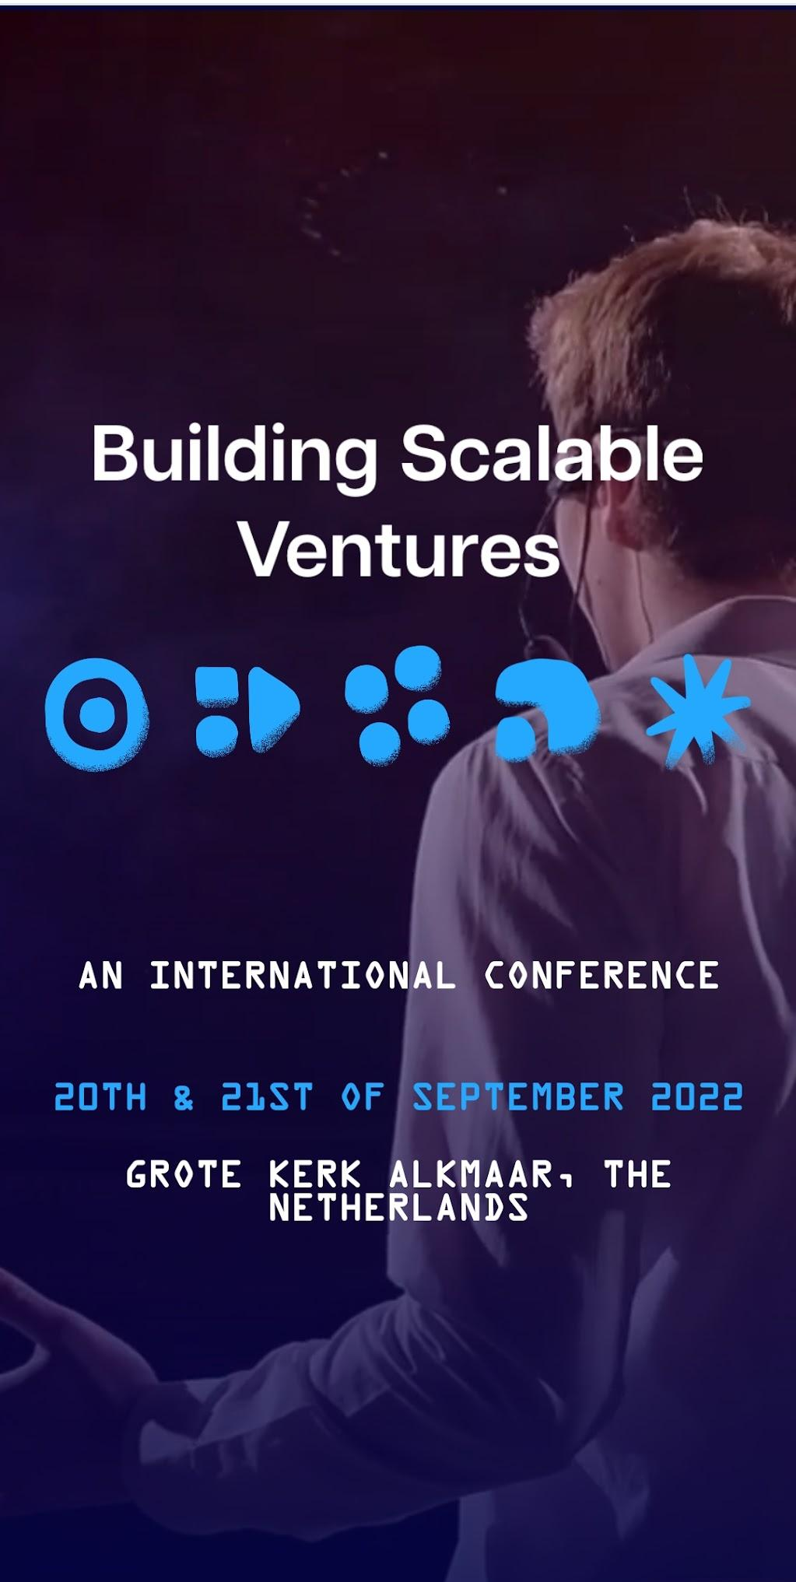
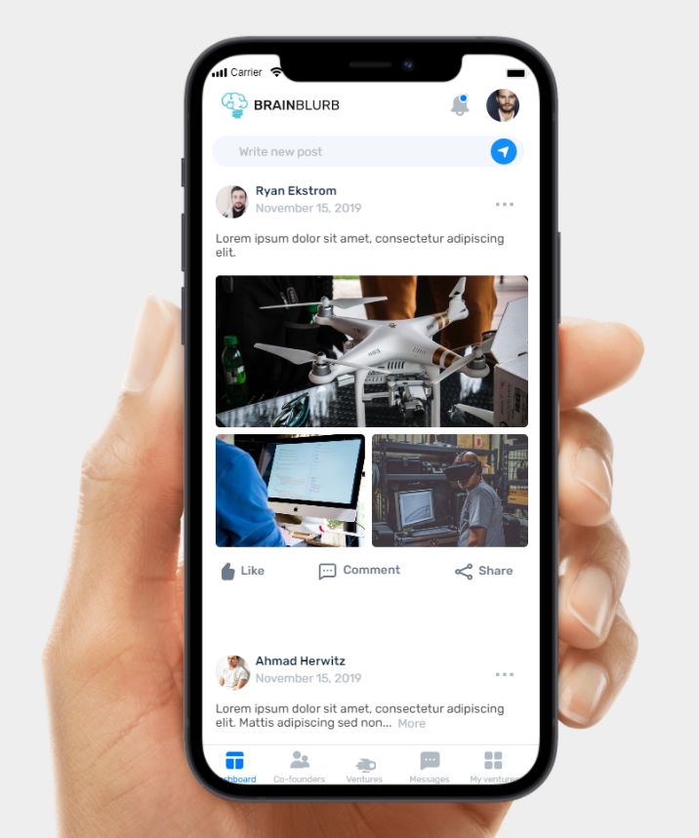
APP, WEB & event

Slide 10
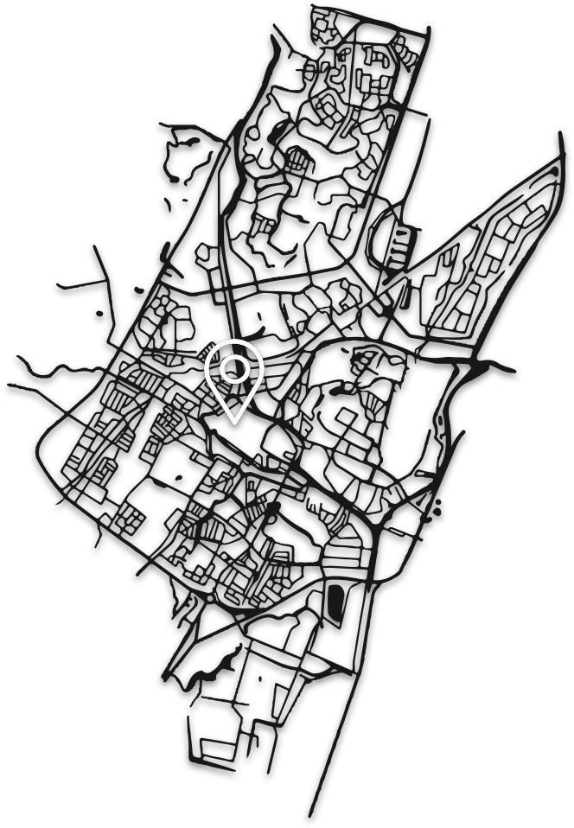
WHO A (local) community of unpaid co-founders
WHAT Creating scalable ventures
HOW
Through high speed MVP development with
low investment and proven strategy
WHERE
Alkmaar, the Netherlands

Slide 11
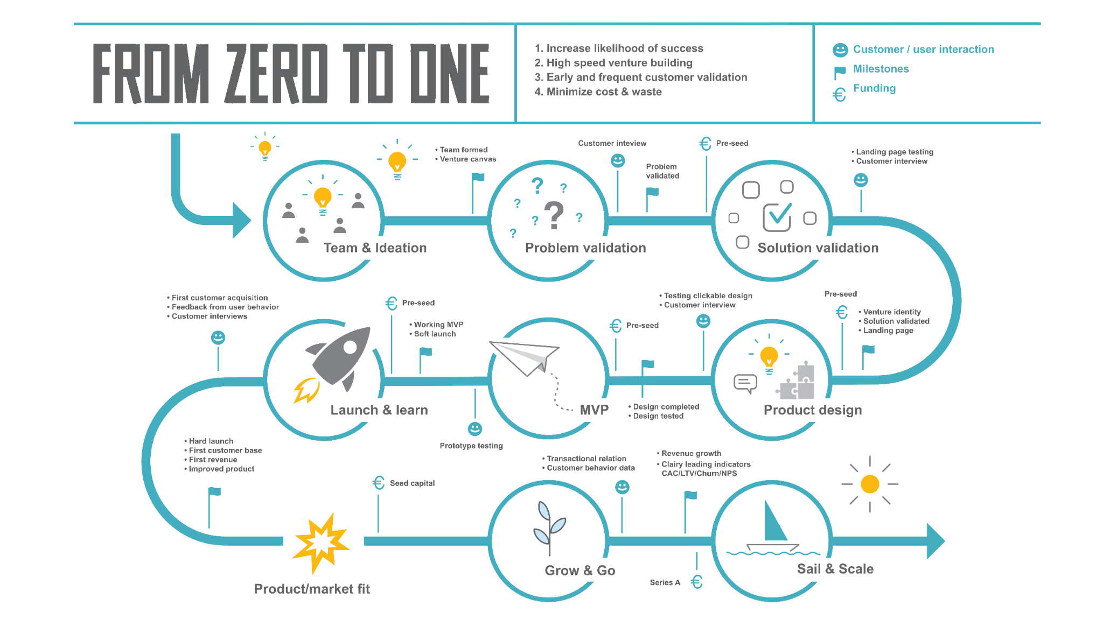

Slide 12
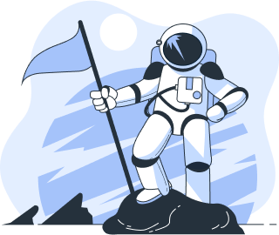
If you have completely lost your mind!
and for some crazy reason, after reading this, still decide to become a member of our co-founders community. Create an account and log on to our online co-founders environment. You will able to interact with other co-founders, who all have taken the BRAINBLURB pledge.
BRAINBLURB.COM

